Slide 1


Mediation Activity:
Translating a written text into speech
Music Festivals in the News

Slide 2
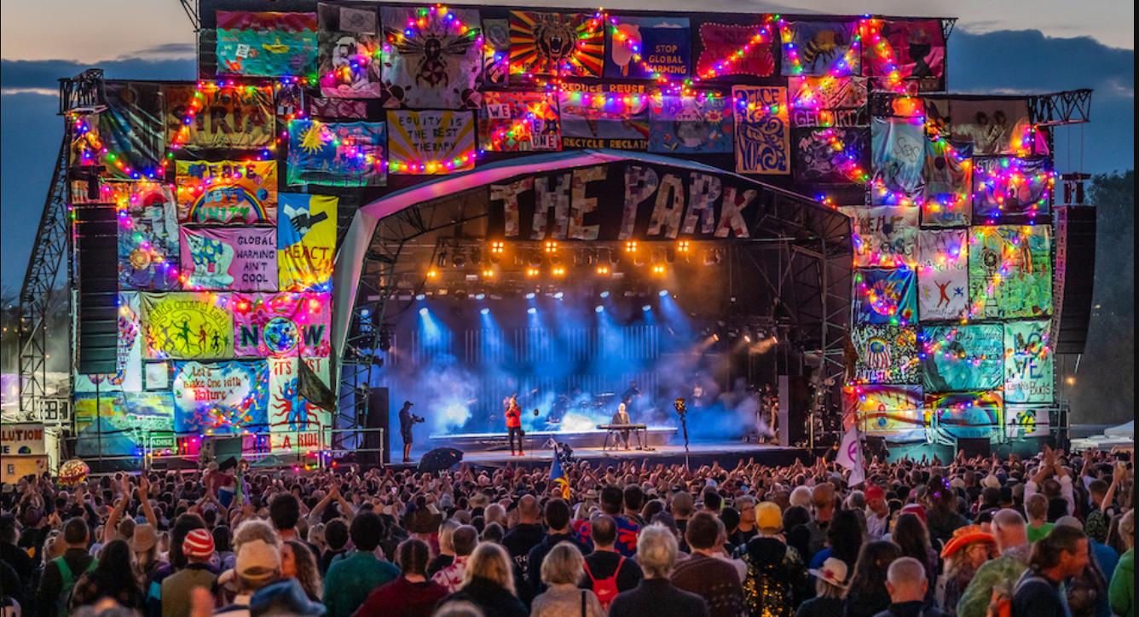

Slide 3
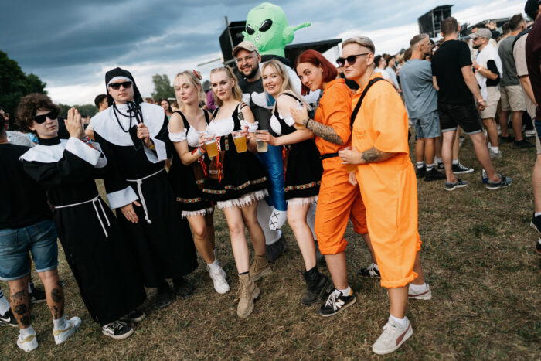
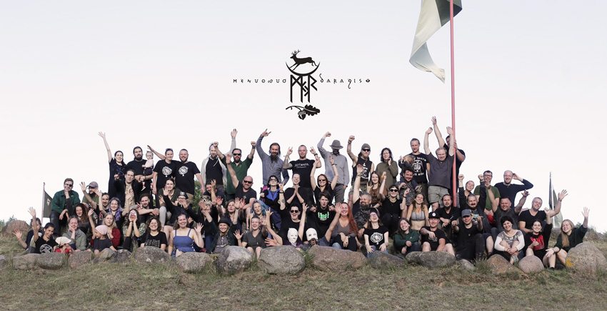
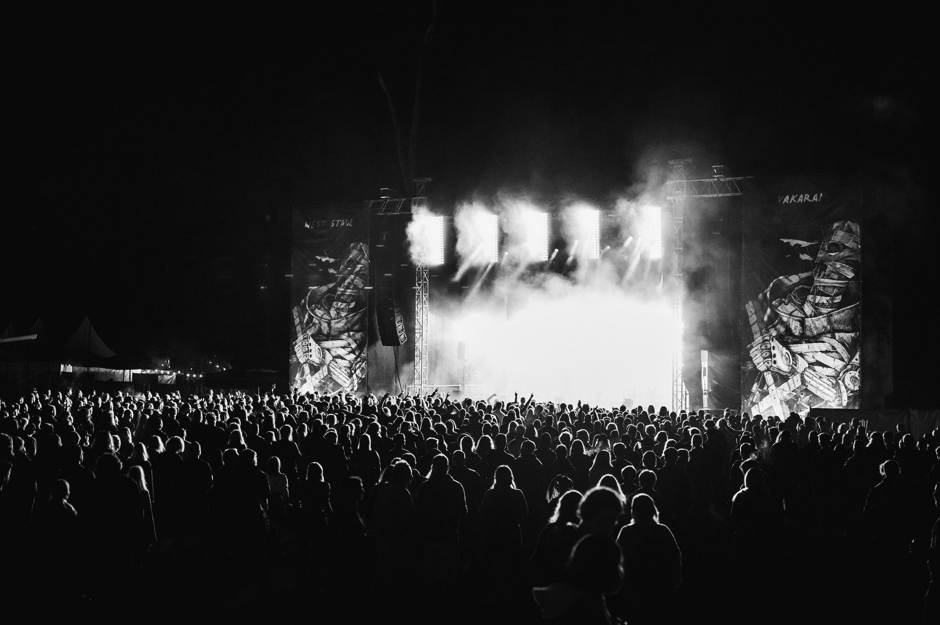
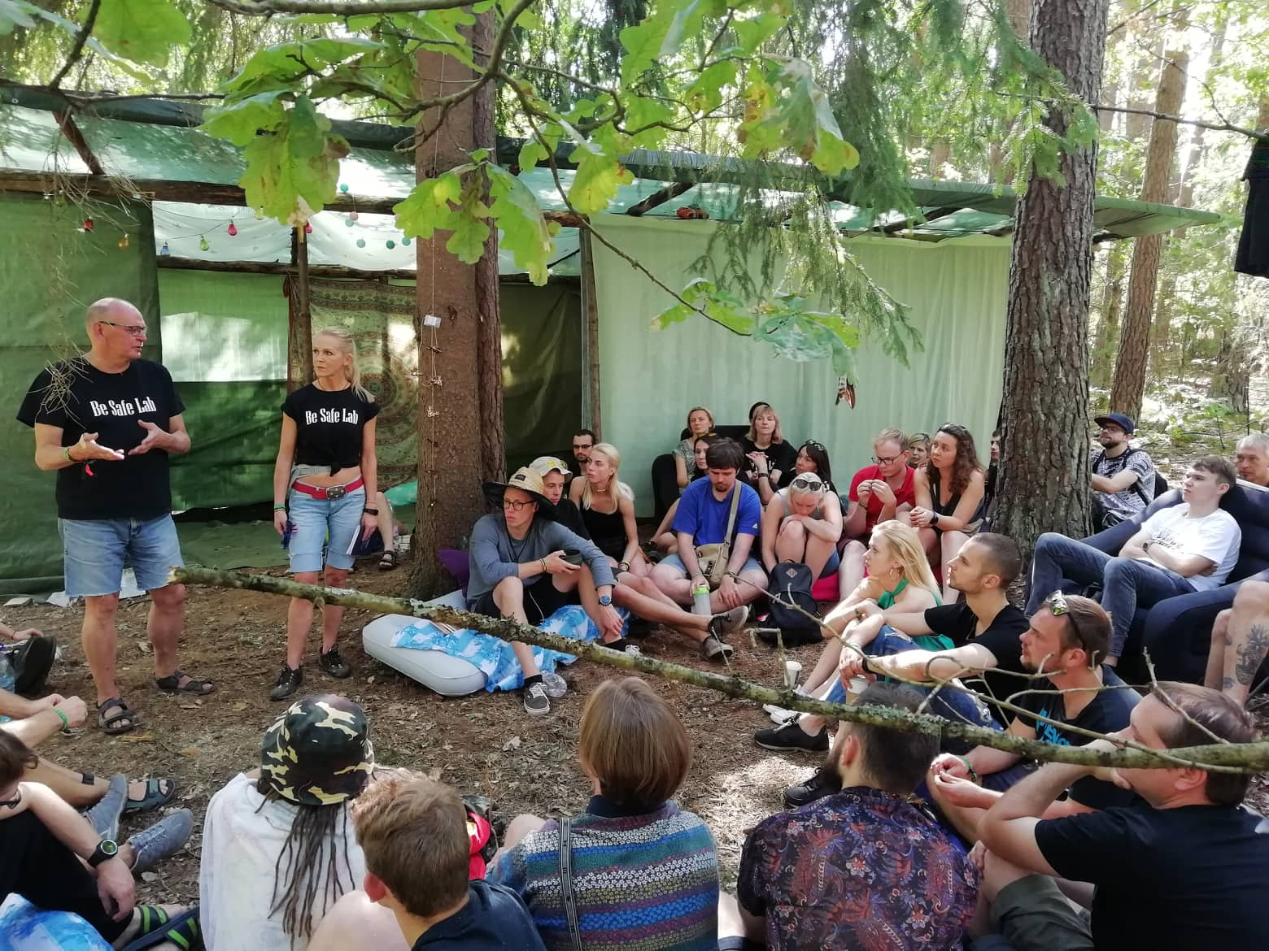
Group A: Granatos Live
Group B: Mėnuo Juodaragis
Group C: Devil Stone
Group D: Yaga

Slide 4
In this lesson you’re going to …
read a news article, in Lithuanian, about something that happened at a particular music festival
translate the key points of the article into English
give a summary / tell us the story
discuss the process, and finally
complete a questionnaire about translating

Slide 5
Developing your spoken mediation skills:
Translating written text into speech
Can provide spoken translation from Lithuanian into English of a text containing information
of personal interest.

Slide 6
How well can you translate an online text in Lithuanian into English?
I can do it …
… easily and very well | +4
… quite easily and quite well | +3
… with difficulty but OK | +2
…with difficulty and badly | +1
I can’t do it. | 0
I don’t know. I never tried | ?
Notes:
This is a simple pre-test, to give the Ss the opportunity to think about whether they can do it and how well.
Read the can-do statement and give them a moment to note their score.
NB don’t forget to return to this at the end of the lesson

Slide 7

Tasks …
Task 1: Read news articles, in Lithuanian, about a music festival.
Make notes about it, in English, and why it was in the news.
Compare notes with the others in your group and prepare to tell the story to a different group.
Task 2: Use your notes, and without referring to the original online text, tell the other members of your team the story.
Task 3: Complete the class survey questionnaire about translating.
Notes:
Organise students into groups of 4. Assign a letter to each student: A to D
Re-group to form “expert” groups - students A together, students B together etc. for task 1
Revert to original groups for task 2 & 3

Slide 8
Group A: Granatos live (gaisras)
Group B: Mėnuo Juodaragis (rąstplėšis)
Group C: Devil Stone (paskutinis)
Group D: Yaga (psichotropinės medžiagos)
Notes:
During the 1st festival, which takes place in the grounds of the openair museum, in 2017 a fire broke out.
The 2nd festival includes an interesting activity which is a type of ancient Lithuanian wrestling using a log.
The 3rd festival will not be held any more.
The 4th is notorious because a lot of attendees use psychotropic substances.)

Slide 9

Task 1: Reading, translating, note-taking
Form groups: students A sit together, students B sit together, etc.
Working individually, then in pairs, and then in 4’s
Read, translate and make notes of your news article, in Lithuanian, about a music festival and why it was in the news
Compare and refine your notes with a partner, and with the group
Prepare to tell your story to another group. You’ll be able to use your notes but not the original article
Against the clock

Slide 10
Task 2: Telling the story (mediating a text by translating and summarising)
Reform original teams: student A, B, C, D in each group
Use your notes, and without referring to the original text, take it in turn to tell the other members of your new group the story.
N.B. Actively Listen to the others in your group – listen and interact to show you understand and to check your understanding
Against the clock

Slide 11



Mediation is interactive
Language
Mediation
She can understand
the text.
He can’t understand the text without her. She helps him understand. It is an interactive process
She can help him by ….
He can help her to help him by ….
Notes:
What is the language skill here? Reading for information & the 2 girls showed that they can read and extract specific, relevant information from a text
What is the communicative skill? Mediation. She bridges the gap between him and the text. It is an information gap. The “problem” is that the 2 girls are more focussed on the information they have to share than on whether their listeners are understanding or even listening (in these activities students aren’t listening, they’re just waiting their turn.
How can she help him understand?
Change her approach:
1. rather than a sustained monologue, she sets up a dialogue by asking him to ask her for the info he needs e.g.
Her: I’ve read about Kazlu Ruda, what would you like to know?
Him: How much does it cost?
Her: €49
Him: what does the price include? etc.
He could / should make notes of her answers
She can signpost e.g. price. It’s €49. For €49 you get: …
What else can she do?
How can he help her to help him? (because she’s concentrating on remembering her info)
He could listen actively e.g. nodding, making sounds to show he is listening. He could echo, recap, summarise, ask questions to show that or what he’s understood.
He could turn it into a Q & A session
He could / should make notes

Slide 12
Analysis & Reflections
Working within your team, share your thinking about the task.
Can you translate and summarise an article from written Lithuanian into spoken English?
If so, how well? Score yourself from 0 – 4, for each (translating & summarising)
How useful was it to translate and summarise the articles?
How interesting was it?
How difficult was it?
What did you learn by doing this?
Would you like to try this kind of activity again?
In your future professional career will you have to translate for people?
In your free time, do you or will you have to translate for people?

Slide 13
Task 4: Summary writing
Students A Granatos Live | Students B Mėnuo Juodaragis
Students C Devil Stone | Students D Yaga
Produce a summary of your article, using your notes to help you.
Work with a partner.
Read your partner’s summary.
Does it include some or all of the key / relevant points?
Is it concise i.e. is it less than ½ of the length of the original article?
Is it well organised i.e. clear, easy to understand, easy to follow?
Does it paraphrase well i.e. uses simplifies and avoids repetition?
Is it accurate i.e. correct vocabulary, grammar, punctuation, and spelling?

Slide 14
Task 4: Summary writing
Students A: Granatos Live | Students B Mėnuo Juodaragis
Students C Devilstone | Students D Yaga
Give your partner feedback:
What do you like about their summary?
What have they done well?
What could be improved?
What advice can you give?
Switch roles, get feedback from your partner & repeat the process
Compare both summaries with the example summary

